Slide 1
Importing Test Grades
Moodle training

Slide 2
Start in Grader report

Slide 3
Check your Excel sheet
First | last | ID | Test 1
Rusty | Can | 912345 | 82
Rusty | Can | 812345 | 95
Jim | Shoe | 712345 | 81
Joe | Snow | 612345 | 56

Slide 4
File, Save as

Slide 5
Pick CSV format

Slide 6
Save on Desktop

Slide 7
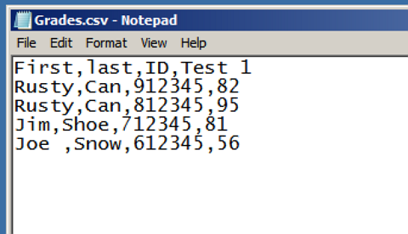
Inside a CSV file

Slide 8
Moodle – Select Grades

Slide 9
Import – CSV file

Slide 10
Upload a file

Slide 11
Browse to the file

Slide 12
Upload Grades

Slide 13
Check item Maps

Slide 14
Gradeitems to pick from

Slide 15
Items are there:

Slide 16
End of lesson
Thanks
Prepare Grade items in Moodle
Prepare excel sheet
Map items in one list to the other

